Slide 1

SMOKER PROPENSITY AND SMOKER LIAR MODEL
Minh Bui, Jeff Hevrin
Brad Zelnio, Matt Hartman

Slide 2


Introduction
Smoker Propensity Model: Predicts which applicant is a smoker
Smoker Liar Model: Predicts which applicant is a smoker liar
Model characteristics:
- Same performance metrics but different distribution and results
- Follow same procedure:
Problem definition
Data acquisition
Modeling
Evaluation
Features
Experimentation

Slide 3
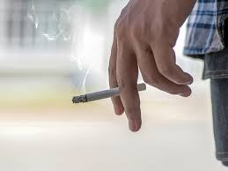
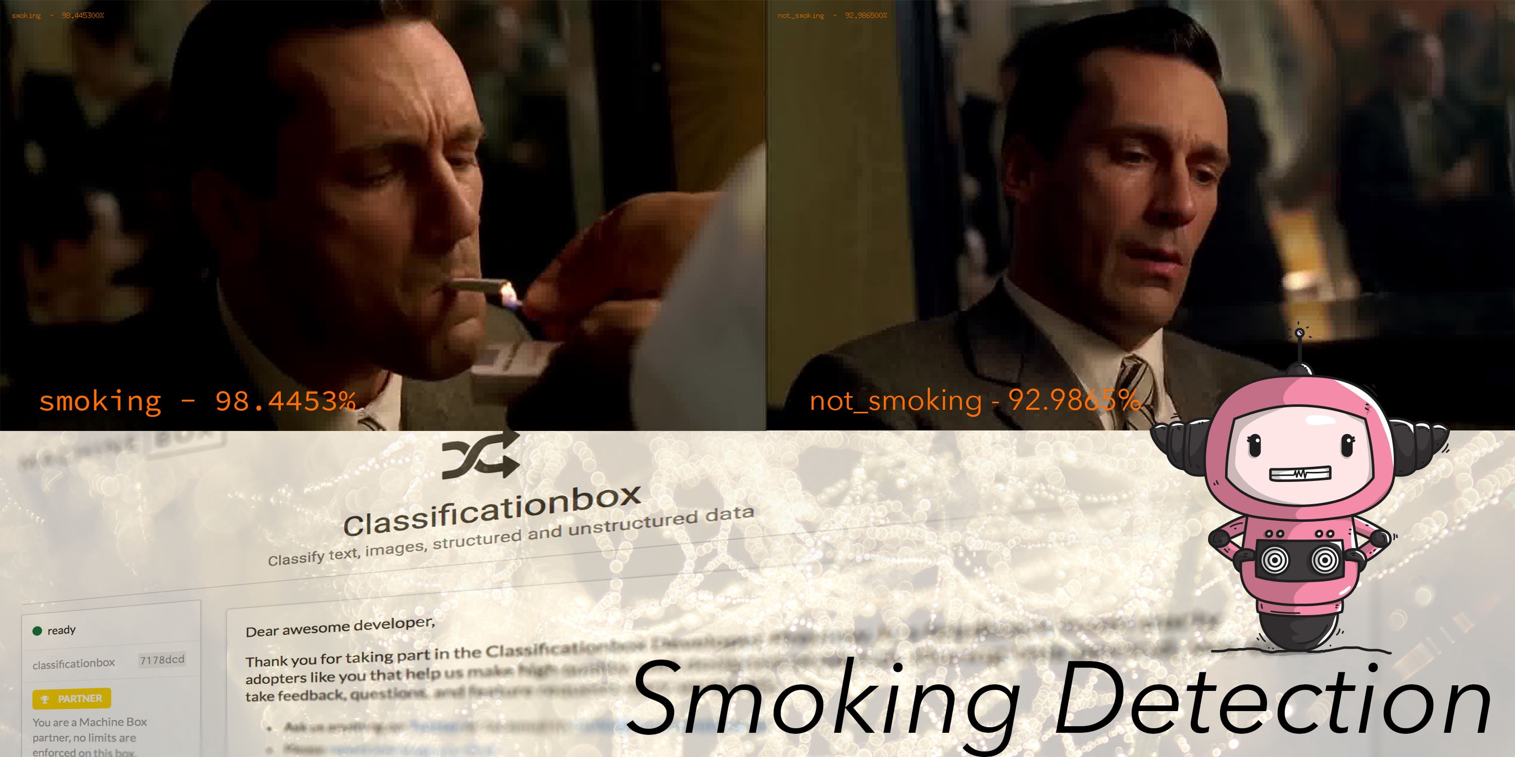
PROBLEM DEFINITION
An insurance fraud: Applicants giving false information about their tobacco use.
Build two models to support the accelerated underwriting process in flagging applicants who are likely to be smokers and smoker liars.
Supervised Machine Learning: figuring out the patterns based on input-output pairs and then apply the pattern to other inputs to find outputs.

Slide 4

DATA ACQUISITION
Data collected from: Application part A, application part B, lab results, therapeutics, and prescriptions
Gender
Height
Weight
Marital status
Age
Product name
Birth country
Income
Occupation
Range values & Range texts
Therapeutics
Part B application questions
- The final model has ~72000 rows and 17 columns, 7 of which contain categorical (non-numerical) values.

Slide 5
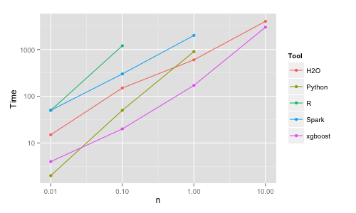
MODELING
Extreme Gradient Boosting (XGBoost)
Fast:
“I also tried xgboost, a popular library for boosting which is capable to build random forests as well. It is fast, memory efficient and of high accuracy”– Szilard Pafka
Popular: go-to algorithm used for data science competition
“When in doubt, use xgboost.” – Owen Zhang

Slide 6
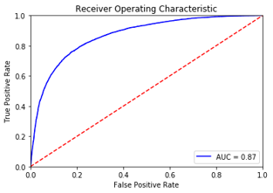
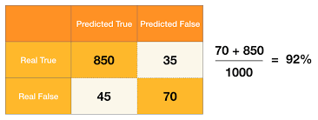
EVALUATION
AUC Score: Area Under the Curve
Measures how well the model distinguishes between two target variables
Should be 0.5 < AUC < 1, 1 is for 100% accurate prediction while 0 is 100% wrong prediction.
Accuracy score:
Accuracy =
Number of accurate predictions
Total number of predictions
- Doesn’t work for imbalanced datasets
Example of a AUC curve
Example of accuracy score with imbalanced dataset

Slide 7
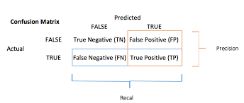
EVALUATION
Precision score:
Recall score:
True Positive
True Positive
Precision =
Recall =
Total Predicted Positive
Total Actual Positive
What proportion of positive identifications was correct?
What proportion of actual positives was identified correctly?

Slide 8
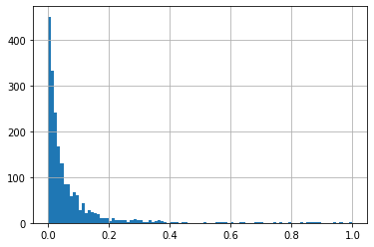
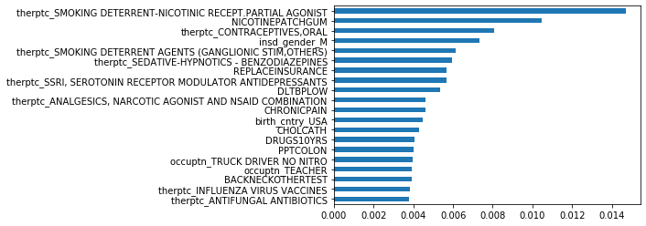
SMOKER PROPENSITY MODEL
AUC score: 0.74

Slide 9
SMOKER PROPENSITY MODEL
Threshold | Precision | Recall | Accuracy
0.1 | 0.21 | 0.44 | 0.7479
0.2 | 0.38 | 0.28 | 0.8857
0.3 | 0.48 | 0.17 | 0.9130
0.32 | 0.50 | 0.16 | 0.9140
0.4 | 0.62 | 0.12 | 0.9170
0.5 | 0.62 | 0.10 | 0.9185

Slide 10
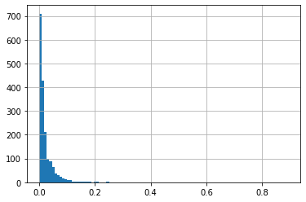
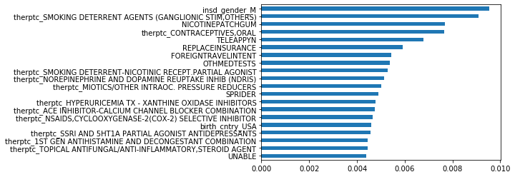
SMOKER LIAR MODEL
AUC score: 0.73

Slide 11
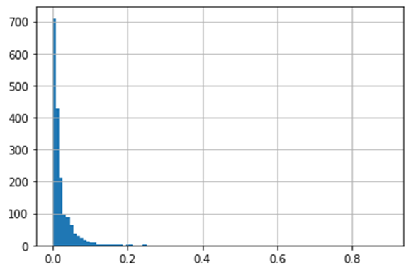
SMOKER LIAR MODEL
Threshold | Precision | Recall | Accuracy
0.1 | 0.21 | 0.16 | 0.9362
0.2 | 0.31 | 0.07 | 0.9597
0.3 | 0.60 | 0.04 | 0.9614
0.35 | 0.75 | 0.04 | 0.9614
0.38 | 1.00 | 0.04 | 0.9614
0.5 | 1.00 | 0.03 | 0.9614

Slide 12
COUNTRY Financial vs. Verisk vs. MassMutual
MassMutual:
“The preprocessed dataset includes ~232,000 applicants, among whom ~8% are smokers. There are 345 predictors, most of which are categorical variables.”
“Using Multi-Layer Perceptron in H2O, the 10-fold cross-validated AUC is 0.70.
Verisk:
“…10,000 records…”
“Currently for the tobacco/smoker model we have achieved an 80%+ accuracy rate in our
test results…”
COUNTRY Financial:
~ 72,000 applicants, ~10% are smokers
AUC is 0.74
Accuracy score is 88%+

Slide 13
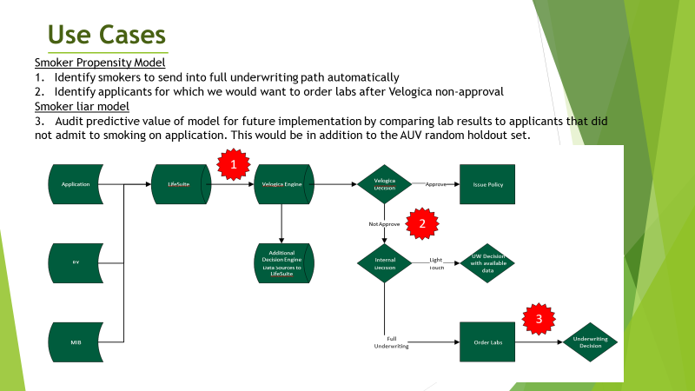
AUW

Slide 14
Next Steps
Socialize with underwriting and actuarial team for feedback
Generating use cases
Feature engineering brainstorming
Determine path for deployment

Slide 15
Thank You!

